Slide 1
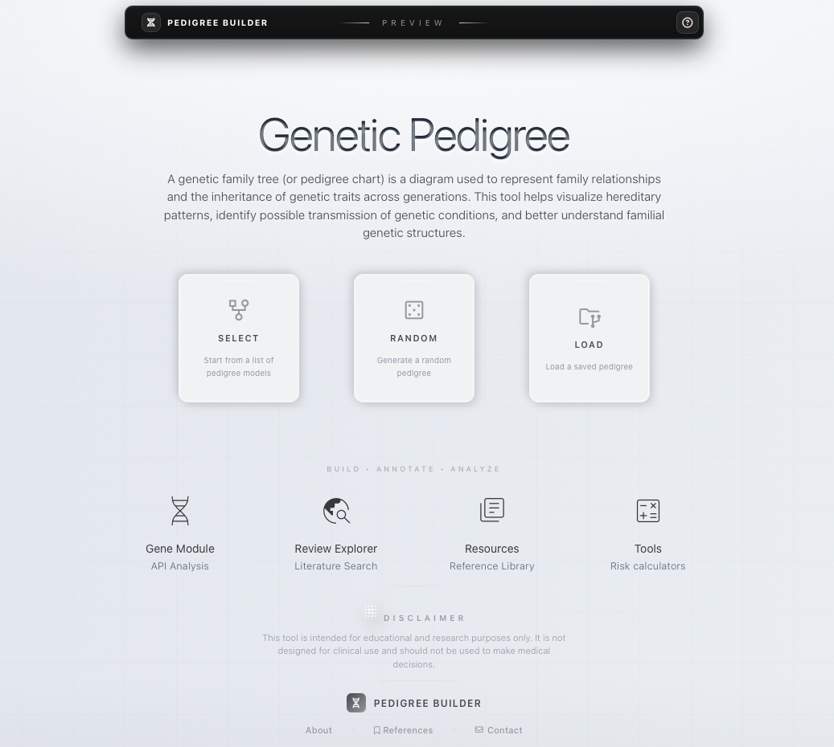
User Interface Redesign
Redesigned the interface for a cleaner and more intuitive user experience.
Added prominent buttons for the application’s primary function: Pedigree Creation.
Organized secondary features into dedicated Learning & Research Tools sections.
Integrated scientific references and supporting resources.
Improved navigation, accessibility, and overall usability.

Slide 2
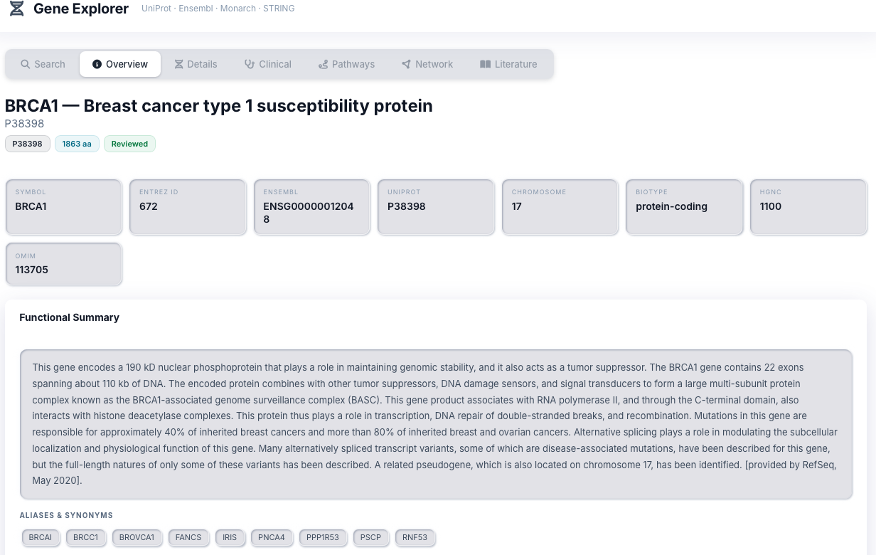
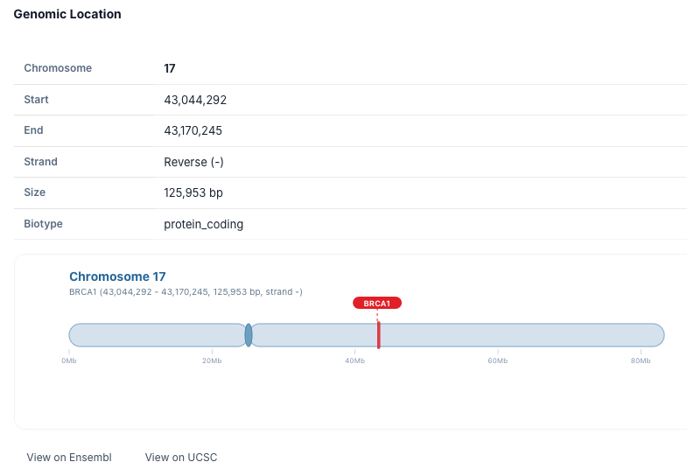
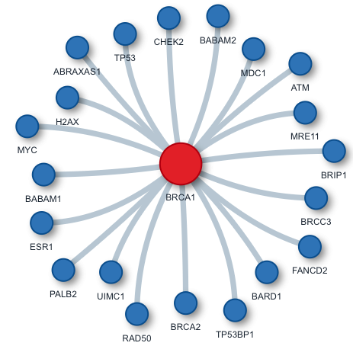
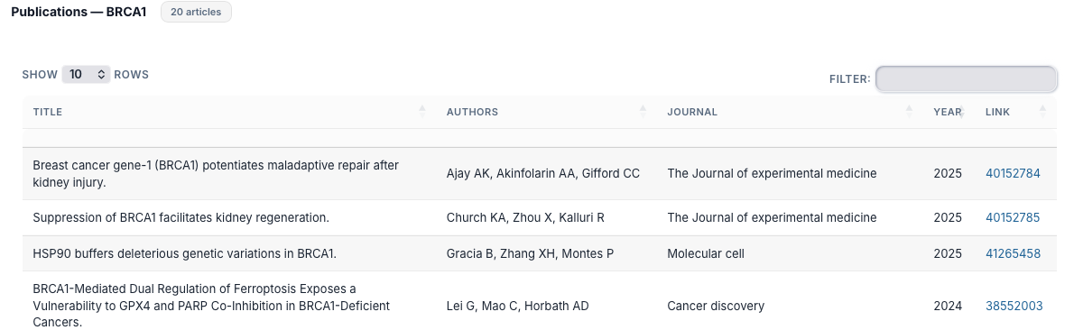
Gene Explorer Provides technical gene information from trusted reference databases through integrated APIs, supporting research activities and molecular genetics education.

Slide 3
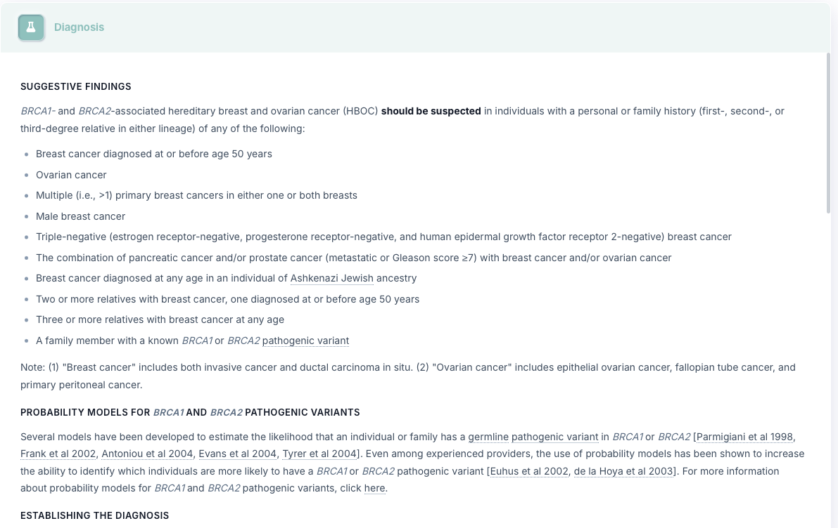
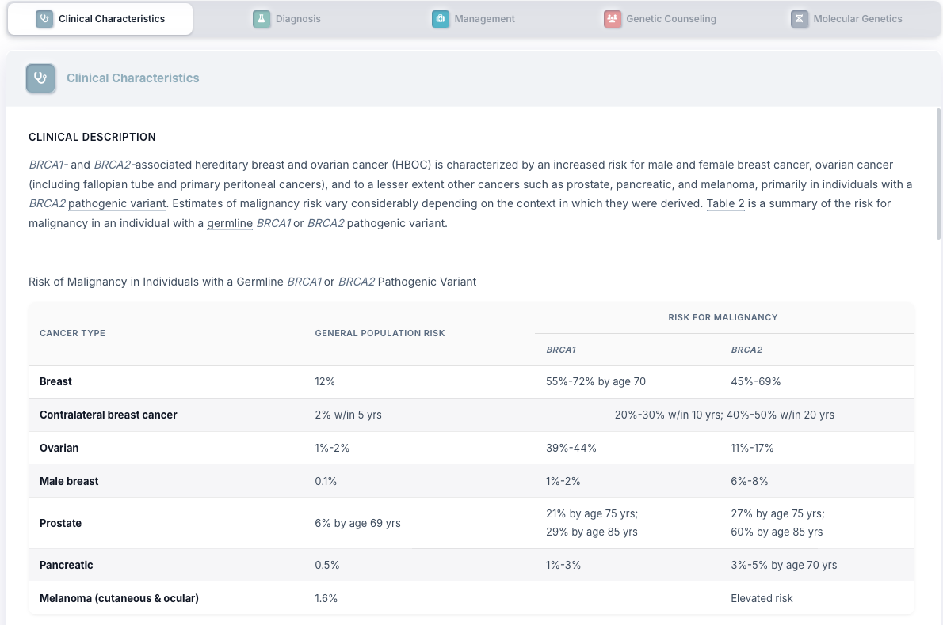
Review Explorer Provides clinically relevant information from trusted medical databases through integrated APIs, including diagnostic criteria, patient management guidelines, risk assessment, and predictive medicine insights.

Slide 4
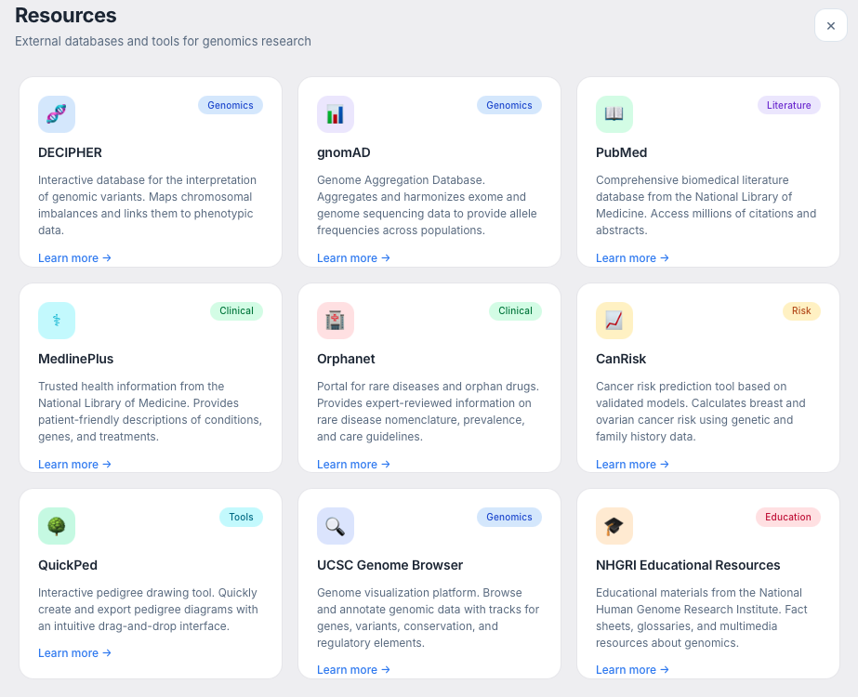
Resources Provides access to trusted reference websites and professional databases commonly used by healthcare professionals, genetic counselors, and researchers for clinical practice and education.

Slide 5
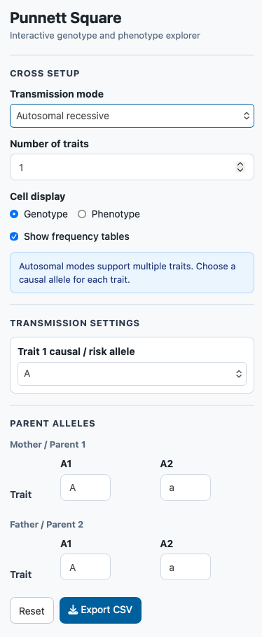
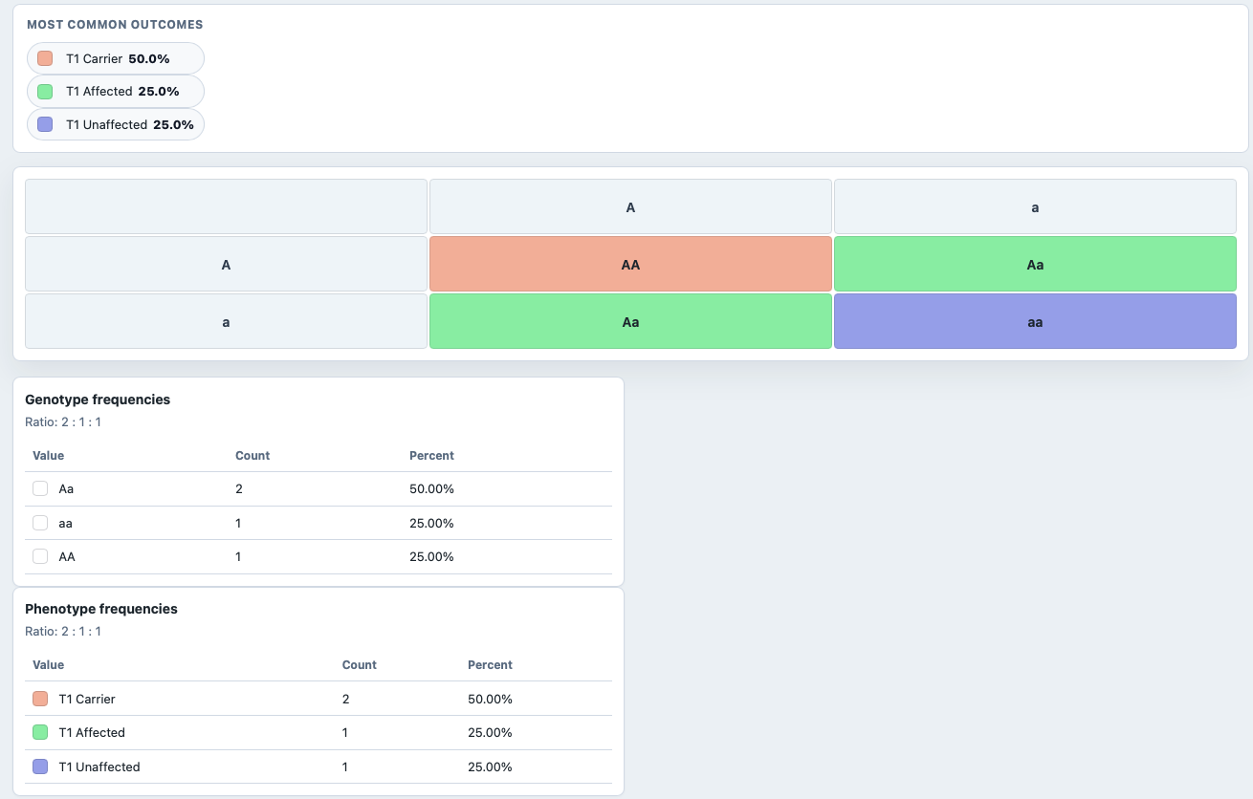
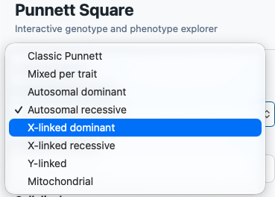
Punnett Square An interactive learning tool that helps users understand inheritance patterns by simulating different modes of genetic transmission and visualizing genotype and phenotype outcomes.

Slide 6
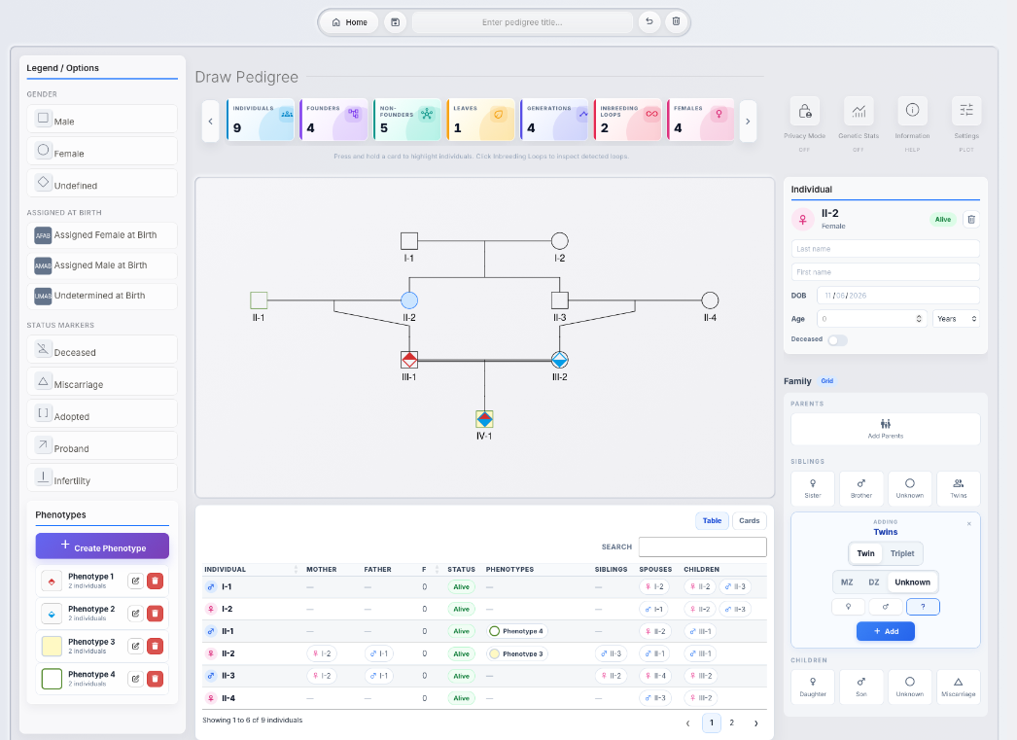
Enhanced Pedigree Display
More comprehensive pedigree visualization.
Added statistics and analytical indicators.
Expanded legend customization options.
Support for overlaying multiple traits and characteristics.
Improved readability for complex pedigrees.

Slide 7
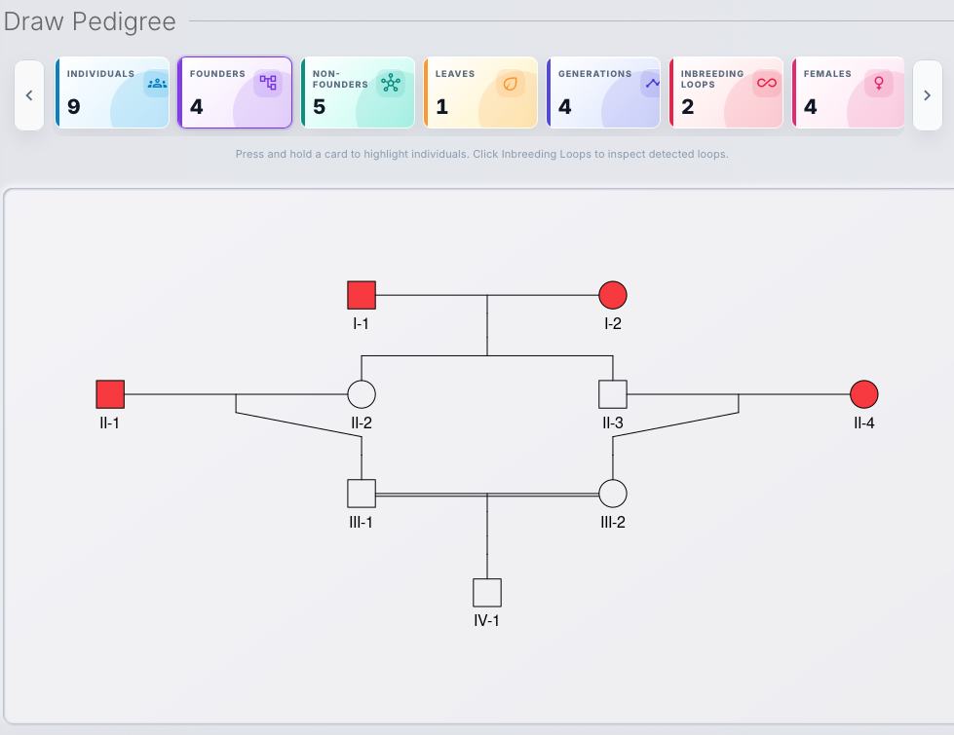
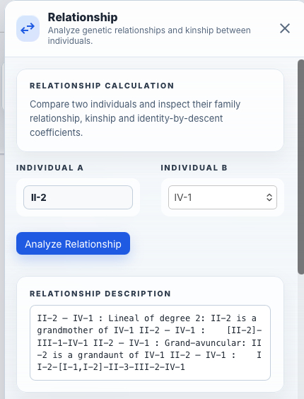
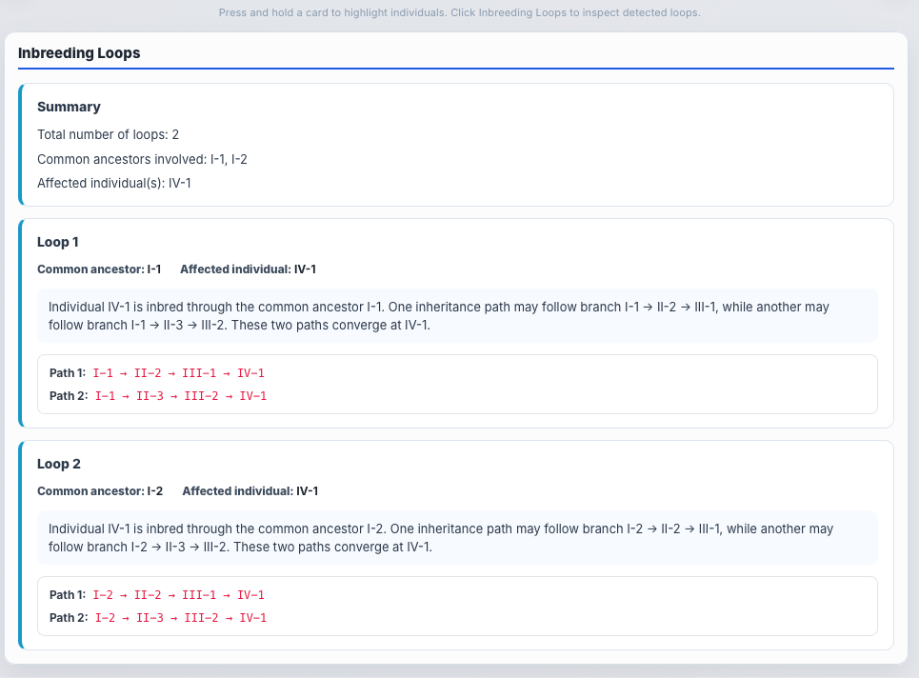
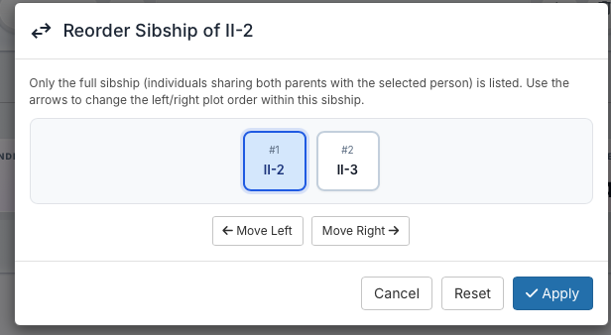
Advanced Analysis Features
Automated kinship and relationship calculations.
Detection and visualization of consanguinity loops.
Repositioning and reordering of individuals within the pedigree.
Improved pedigree organization and interpretation.

Slide 8
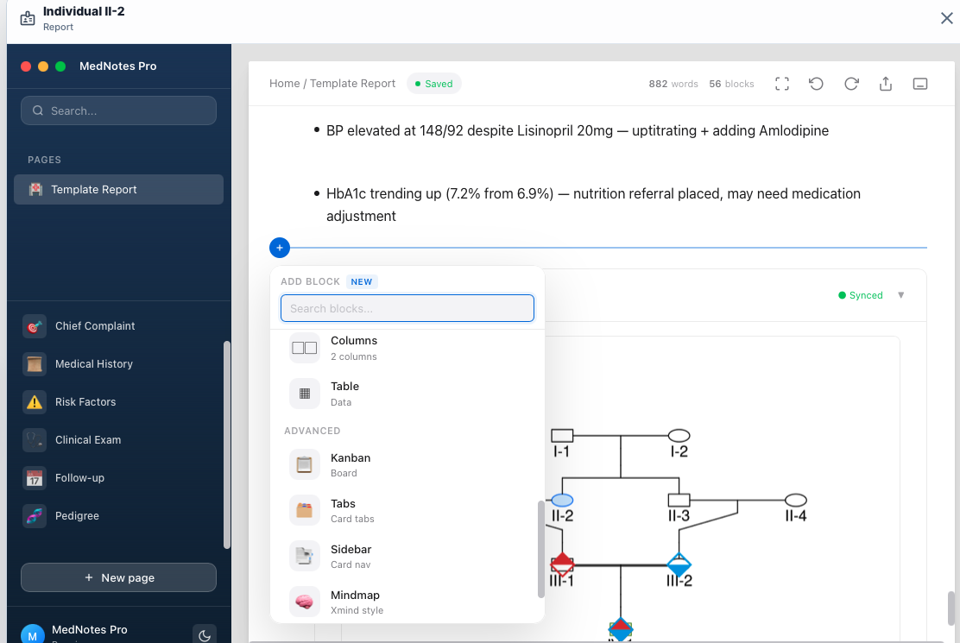
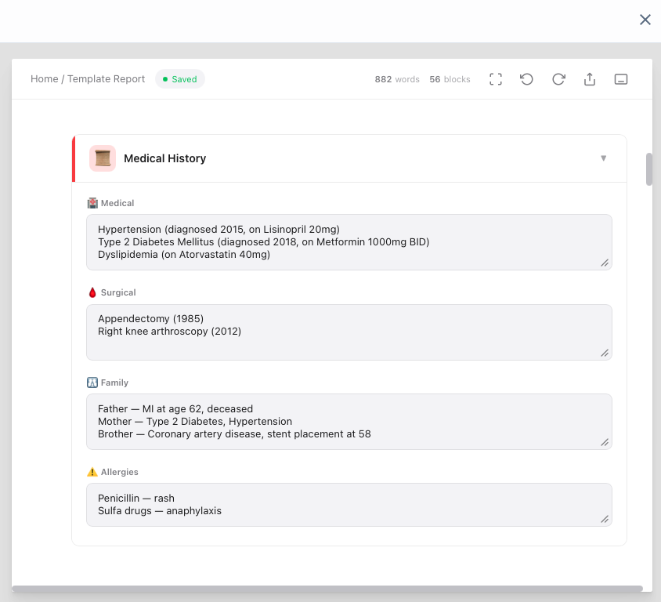
Individual Report Generation
Double-click on an individual to generate a structured report.
Built on a modular block-based architecture.
Integrates pedigree findings, clinical information, and genetic analysis.
Designed to support clinical assessment and patient management.

Slide 9
